Slide 1


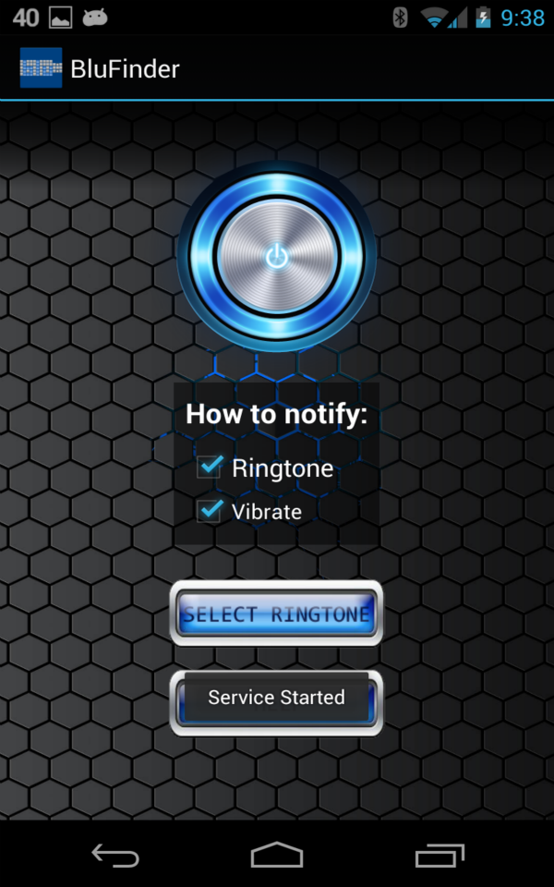
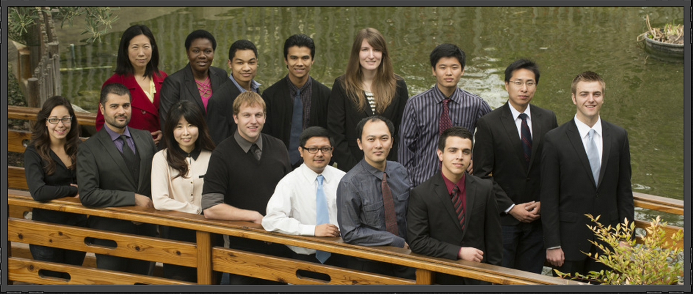
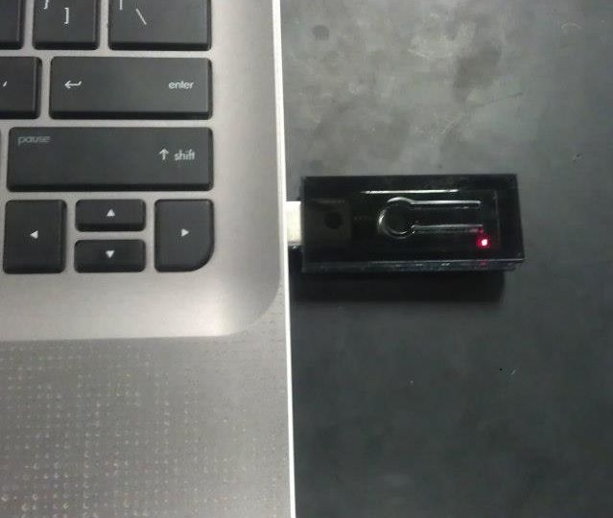
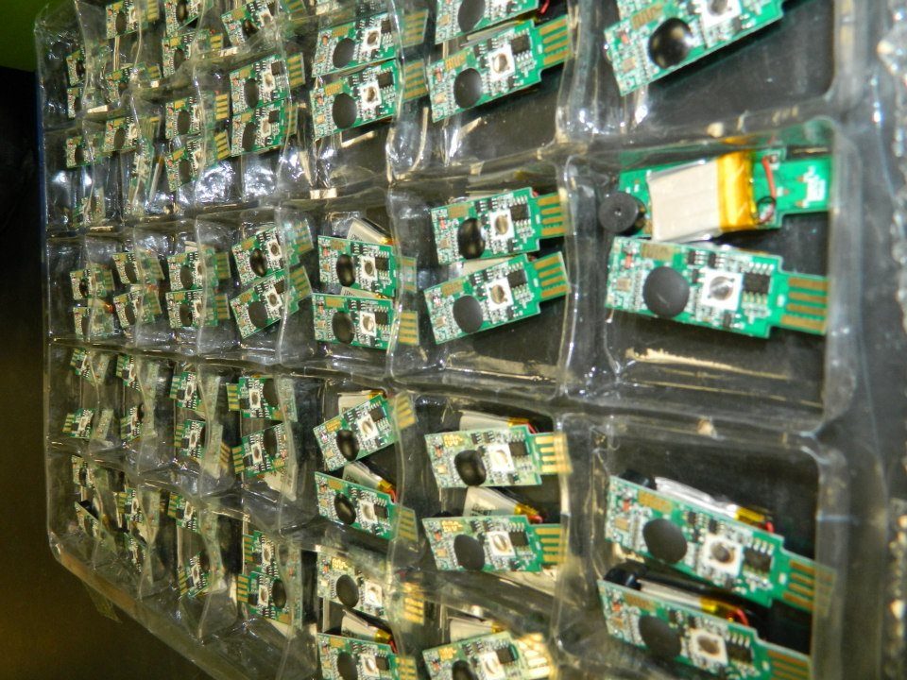
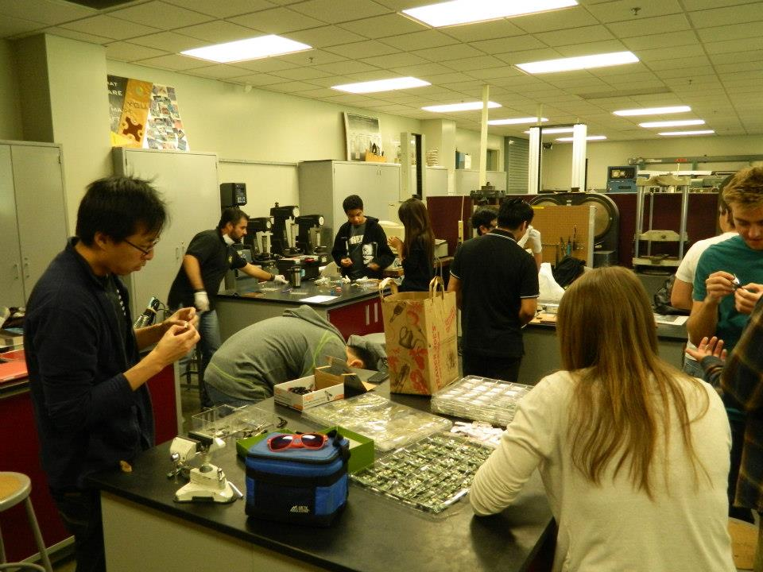
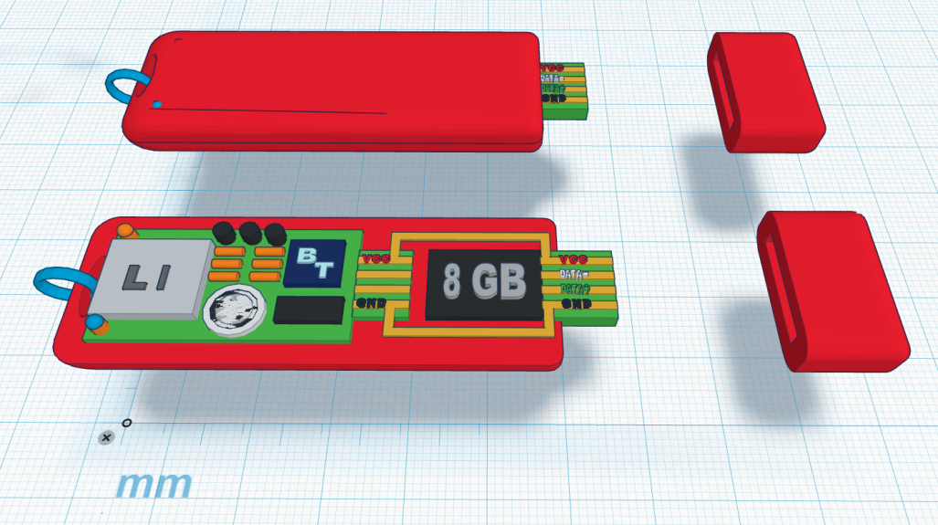

Poly Presents: Blu-Finder
Poly Presents
Security
The Cal Poly Pomona company is led by students with different majors including science, engineering and business. There are 13 students and 3 faculty advisors.
The students work together as an interdisciplinary development team and share their background knowledge to imagine, design and manufacture a product .
This collaboration allows the students gain experience in entrepreneurship, reinforces teamwork and gives insight into mechanics companies operate with.
Poly Presents is the ultimate testimony of Cal Poly’s “learn by doing” philosophy.
What does your flash drive contain?
Resumes, CVs, Applications, Syllabi
Assignments, Lab Data, Essays, Grades
Photos, Music, Videos, Documents
Plugins, Drivers, etc.
The price to replace your lost belongings?
Money, Time, Energy, Stress and Inconvenience
Don’t miss a deadline because you lost your flash drive!
Blu-Finder
Blu-Finder combines a USB flash drive with a Bluetooth device, which alerts the owner in the event their precious device is forgotten.
Blu-Finder has a locator function that allows for Android phone users to use an application and find their device.
The application will also serve as a shortcut to the user’s Bluetooth setting and provide a selection of tones and vibrating sounds.
The USB Bluetooth device will also come with a rechargeable battery that will charge via USB plug-in, so it can be charged while it is working!
Motivation
For students to gain hands-on experience in the areas of business, management and engineering, completing tasks they may not be accustomed to.
To address the need for a solution to a problem of lost flash drives and the panic that comes with losing one. Data collected at Cal Poly showed that many Broncos have lost vital information.
To expand and network throughout Cal Poly Pomona and beyond, helping the students and the school grow.

